Slide 1
Homework #4: due Monday, Sept. 26, 9:00 pm
Exam 1: Wednesday, Sept. 28
Chapters 1-4, Lectures 1-10, Homework 1-4
Exoplanet Project Part I due Weds., Oct. 5, 5:00 pm,
Instructions & Guide posted on Canvas
Submission instructions to come

Slide 2
Special showing of The Martian
Wednesday, October 5, Swain West 007, 7:00 pm

Slide 3
How did the solar system, and presumably other planetary systems, form?
What are the “observed facts”?

Slide 4
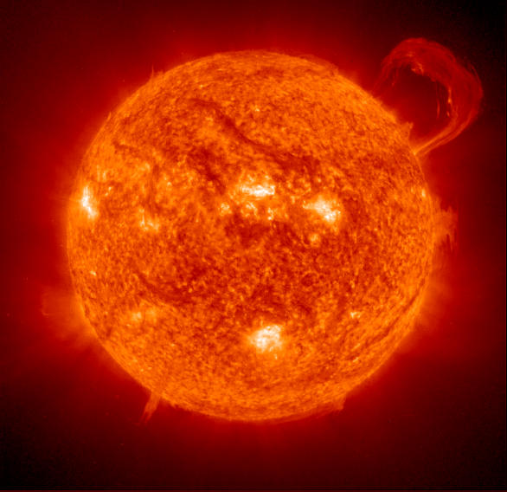
Solar system is dominated by a central star, the Sun: Most of the mass in the solar system (~ 99.8%). Predominately (98%) Hydrogen and Helium Rotates in same sense that planets orbit.

Slide 5
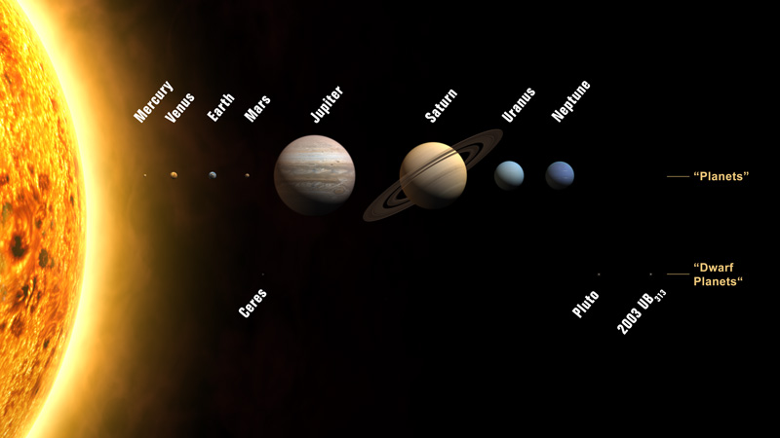
Two “flavors” of planets in Solar System
Terrestrial
Jovian
small large
rocky/metallic gaseous/icy
hotter colder
No rings rings are ubiquitous
Slow rotation rapid rotation
Solid surface not solid
minimal atmosphere substantial atmospheres
few/no moons many moon

Slide 6
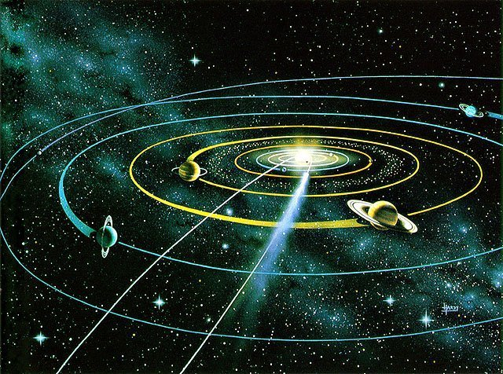
Planetary orbits:
1) prograde (same direction)
2) approximately coplanar
3) approximately circular
Rotation:
1) Mostly prograde
2) Including the sun
3) Includes large moons

Slide 7
Large numbers of smaller objects in the Solar System
moons: both rocky & icy
asteroids: rocky
comets: icy
}
“Planetesimals”

Slide 8
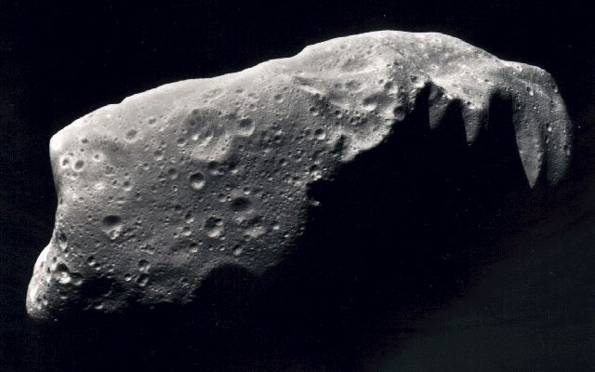
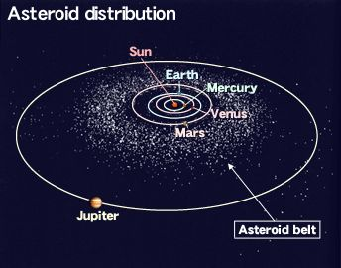
Asteroids
rocky
Odd-shapes
nearly circular orbits
orbit planes are near Ecliptic Plane
Located in inner solar system:
mostly between Mars & Jupiter
Some “Earth-crossing”

Slide 9
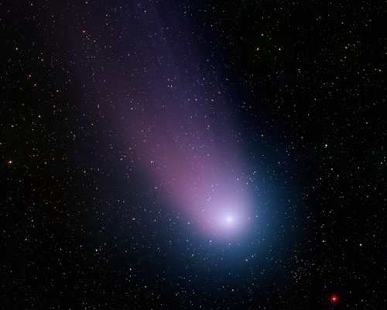
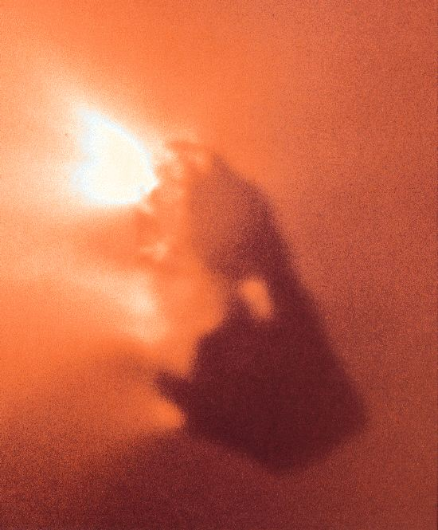
Comets
small solid nucleus
“dirty snow ball”
highly eccentric orbits
very long “tails” (when “near” the Sun)
all orbit inclinations

Slide 10
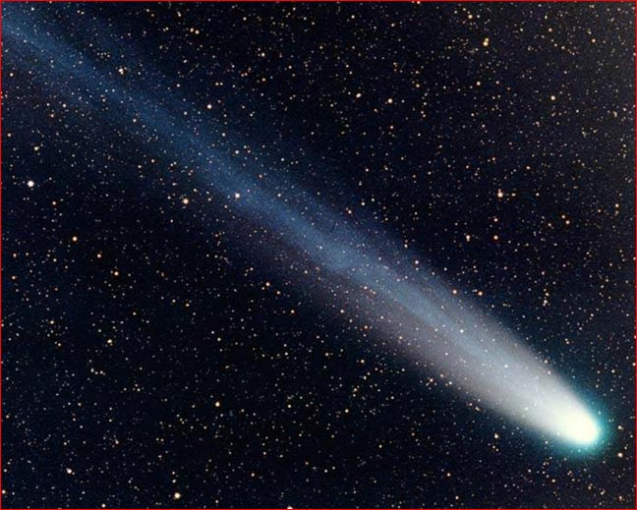
Comets
small solid nucleus
“dirty snow ball”
highly eccentric orbits
very long “tails” (when “near” the Sun)
all orbit inclinations

Slide 11
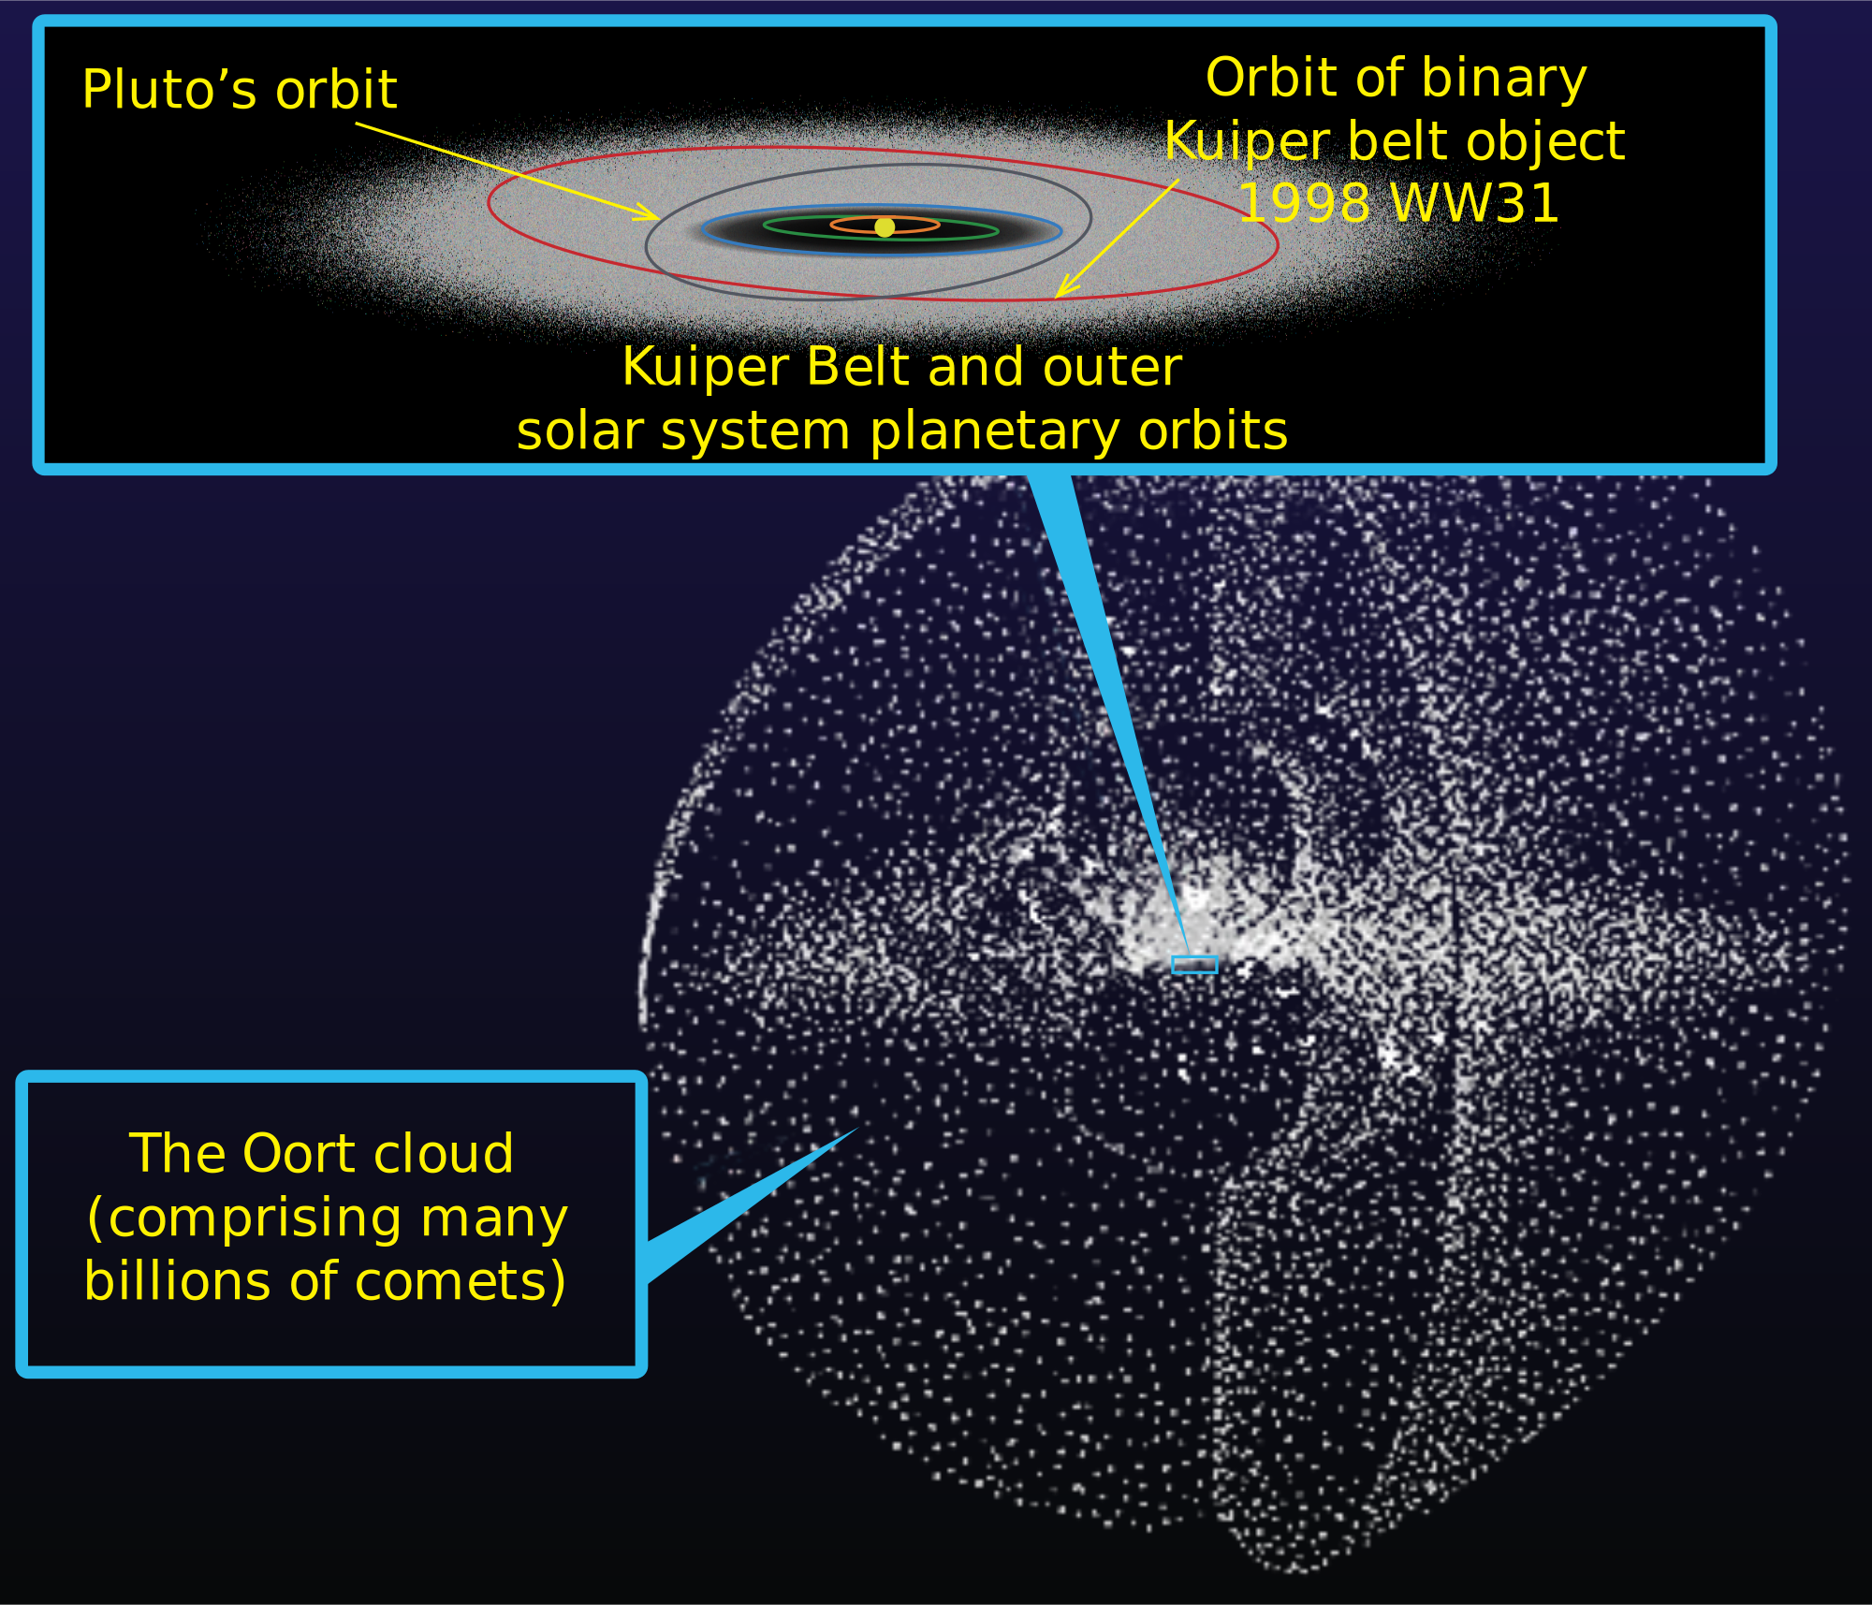
Comets are found mainly in two regions of the solar system

Slide 12
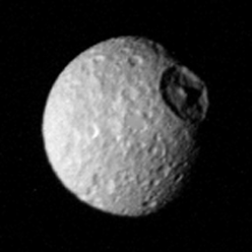
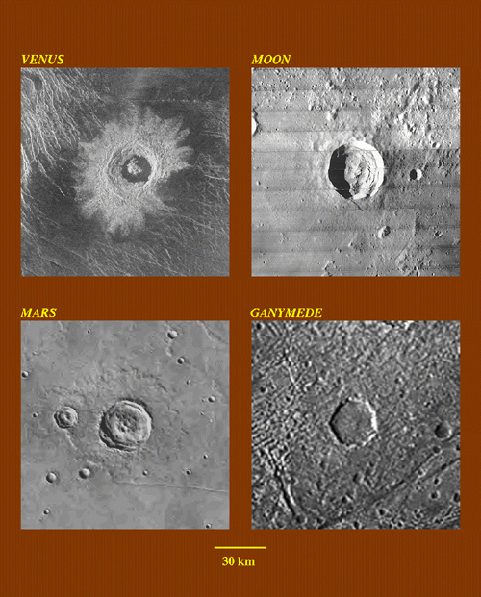
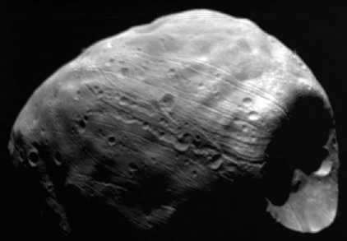
Craters are ubiquitous on solid objects

Slide 13
How do we account for what we see in the solar system?

Slide 14
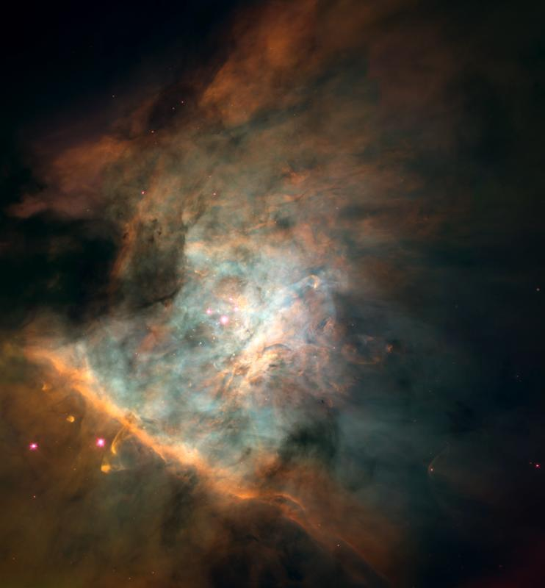
The Nebular Theory
The Solar system was formed from a giant, swirling interstellar cloud of gas and dust “the solar nebula”

Slide 15
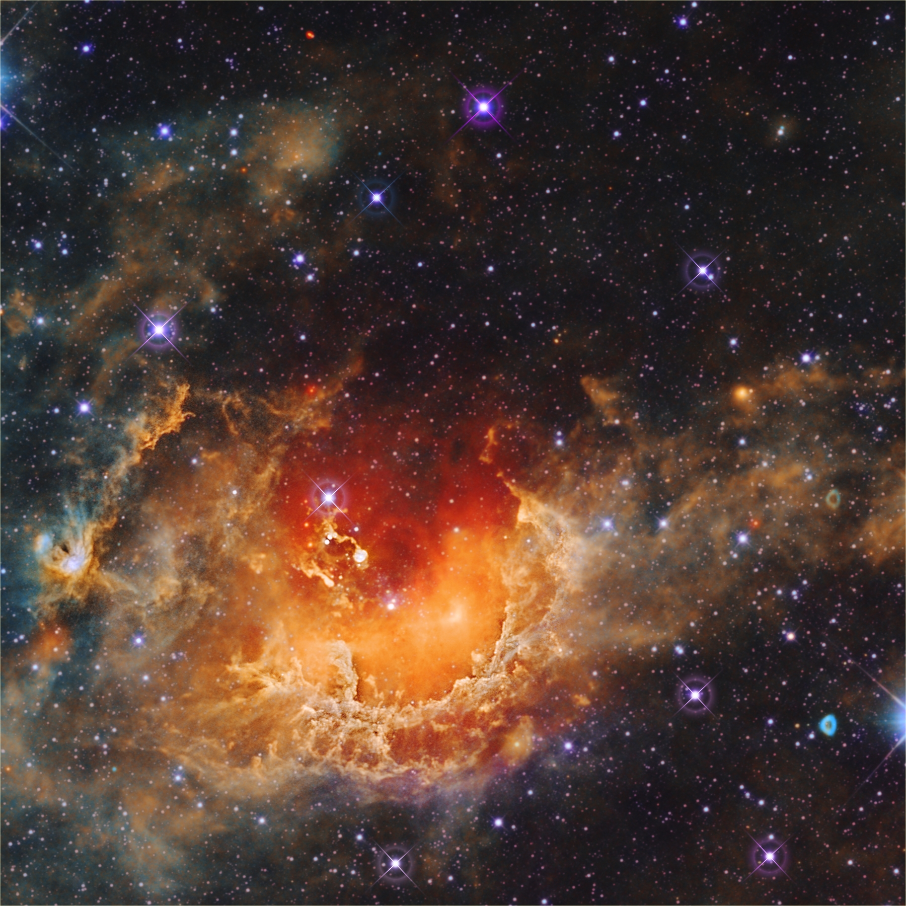

Slide 16
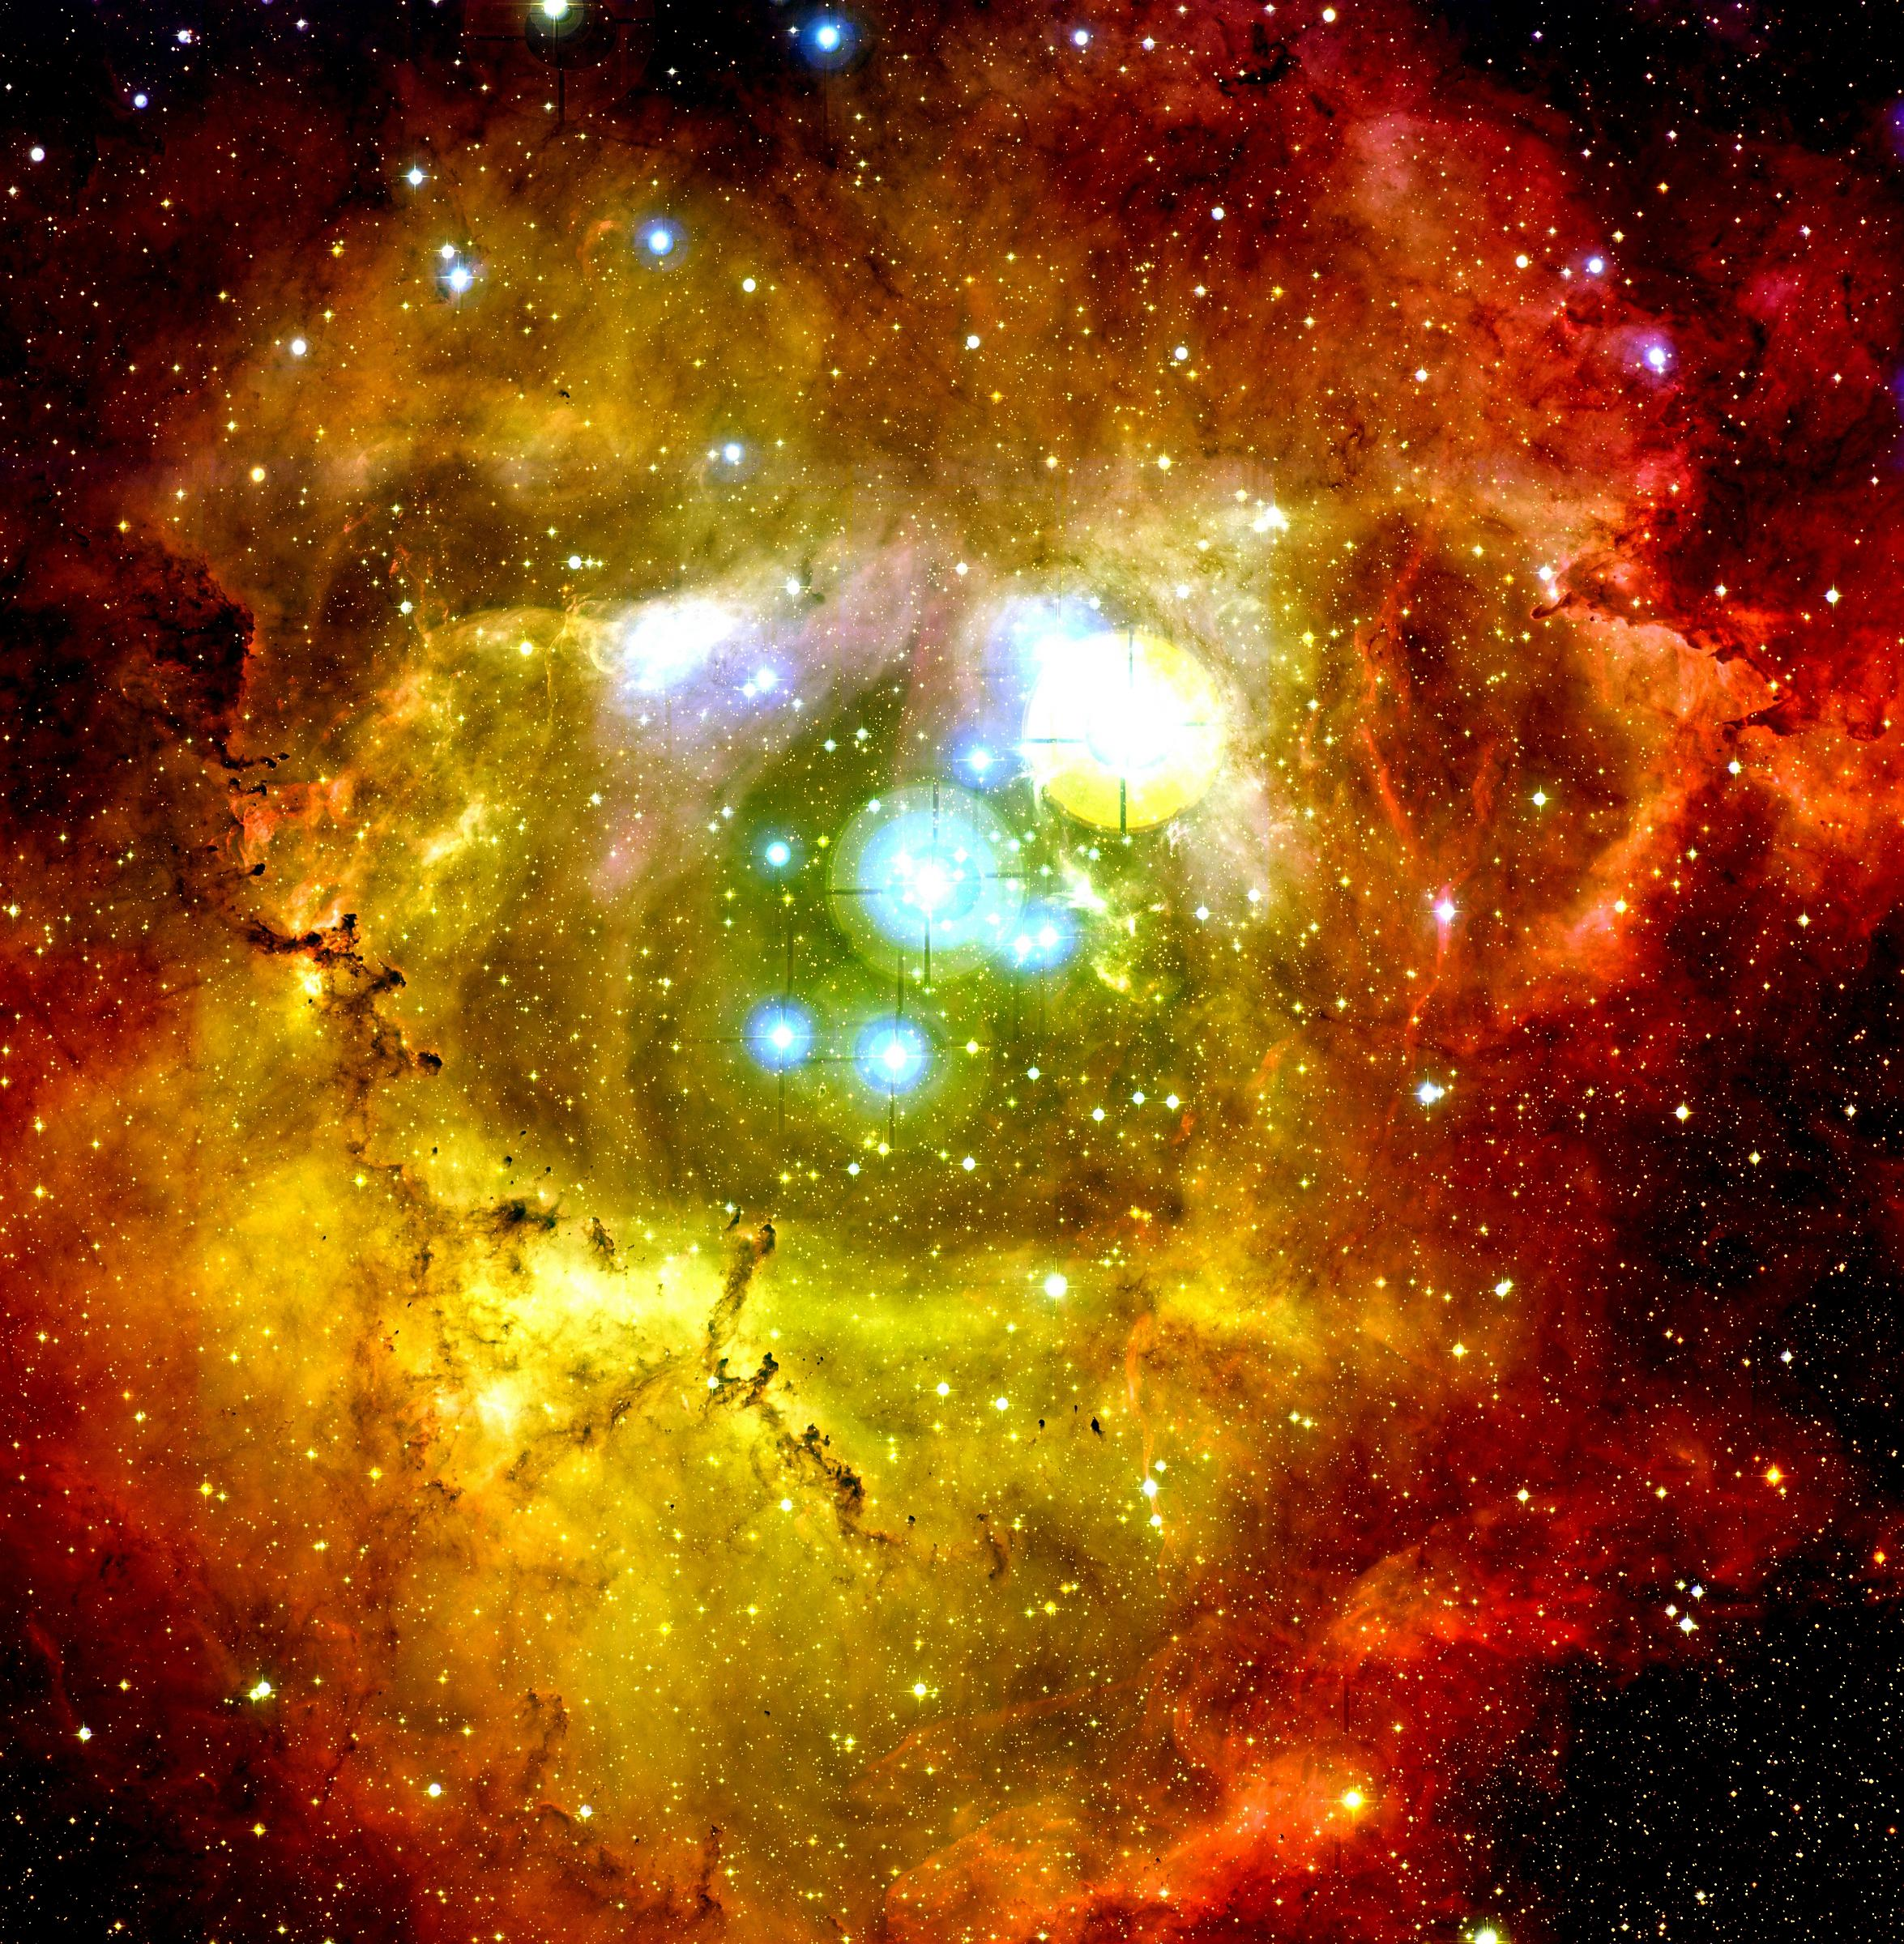

Slide 17
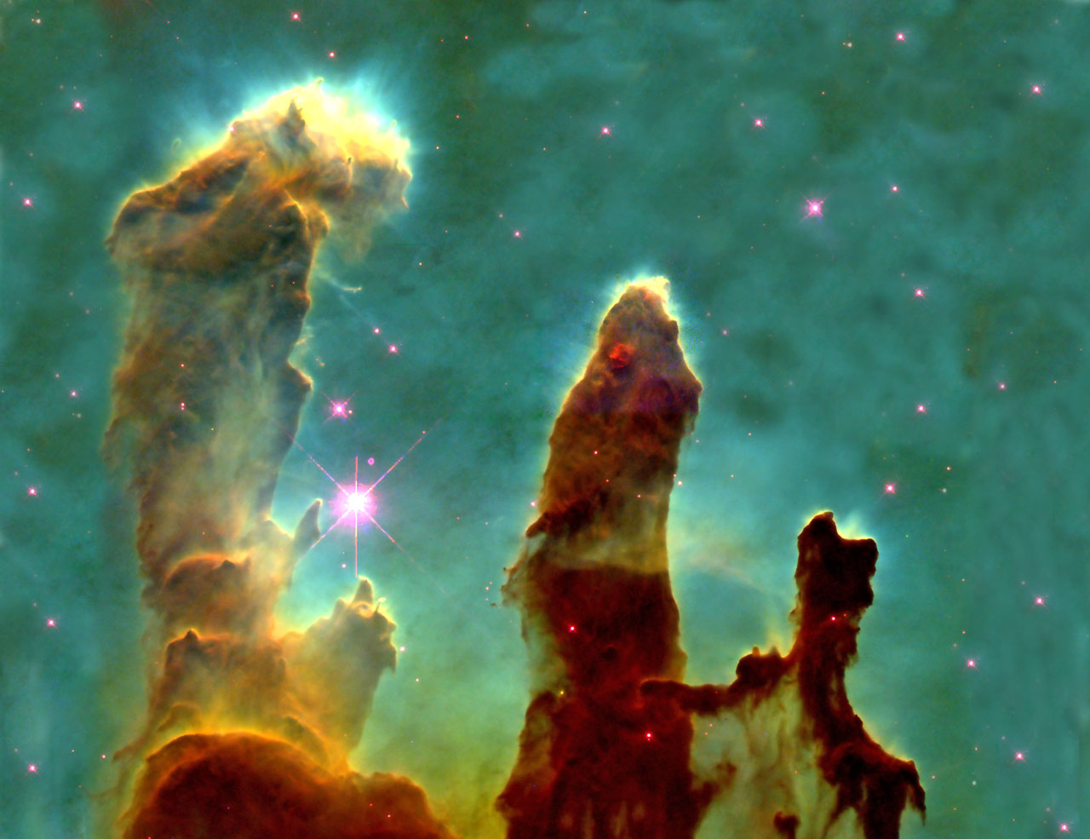

Slide 18
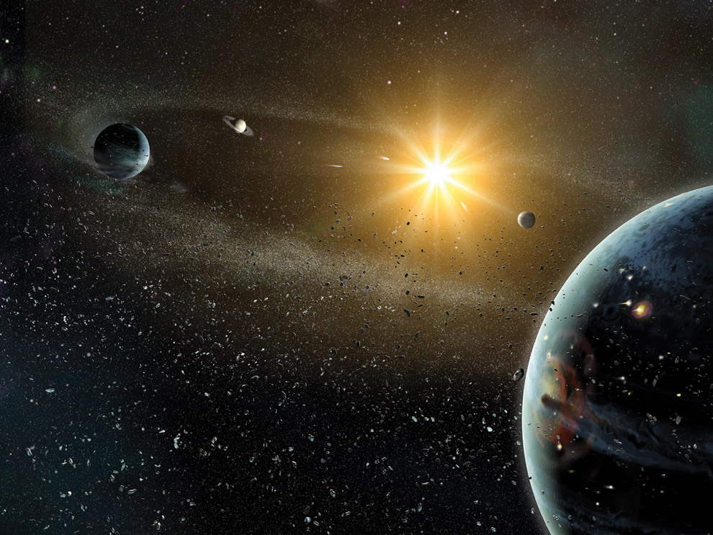
Formation of the Solar System
Gravitational Collapse
Condensation
Accretion
Nebular Capture (giant planets)
Gas clearing by solar wind
Massive Bombardments

Slide 19
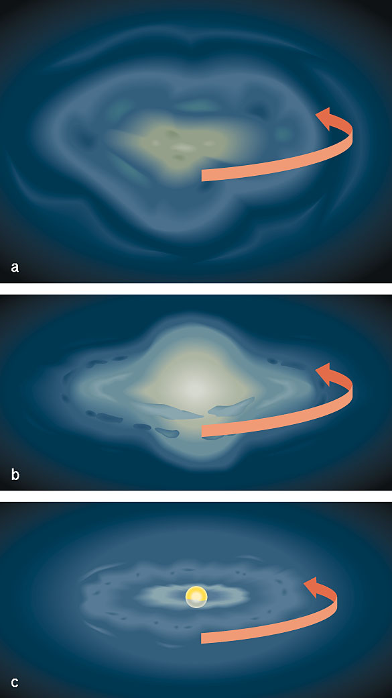
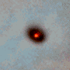

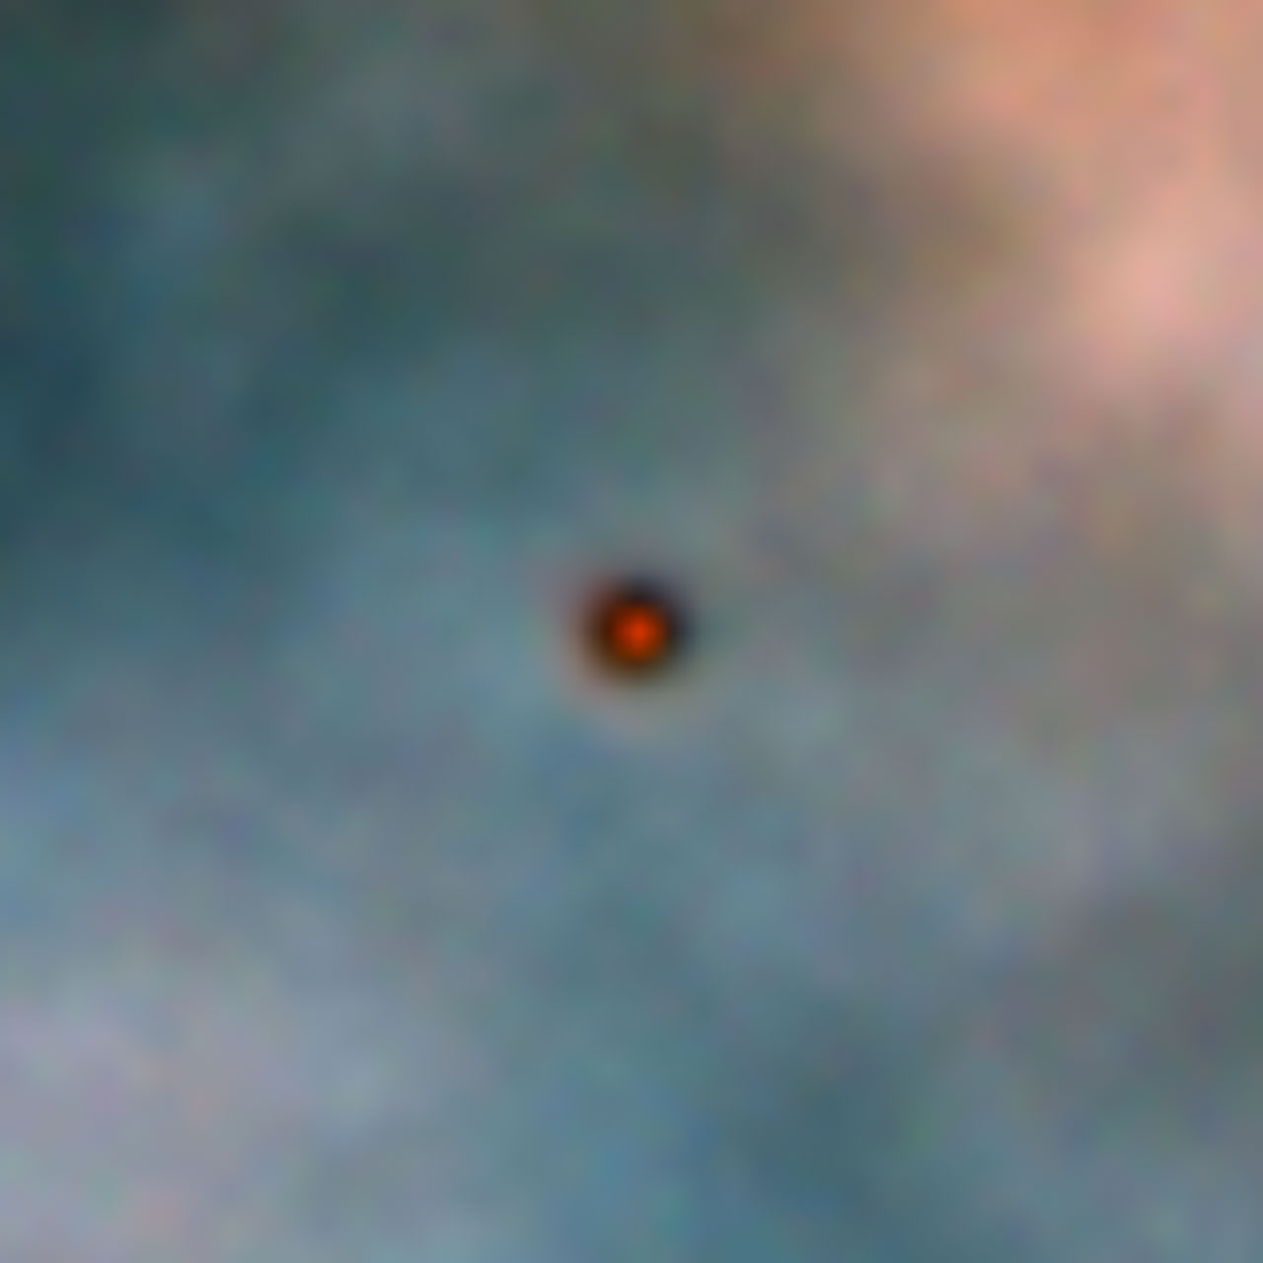
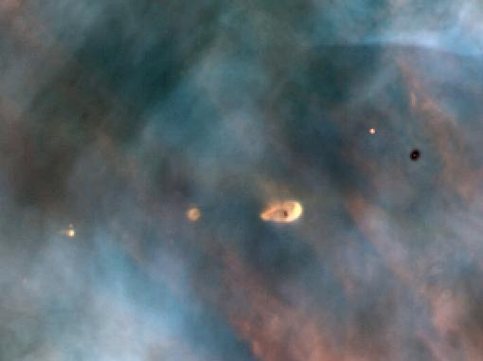
GRAVITATIONAL COLLAPSE OF PROTOSTELLAR CLOUD INTO A ROTATING DISK
Temperature increases:
Conservation of energy
Rotation rate increases:
Conservation of angular momentum
Rotating cloud flattens into a disk: ”protoplanetary” disk
Motions of material in disk circularized: (from collisions within disk)

Slide 20
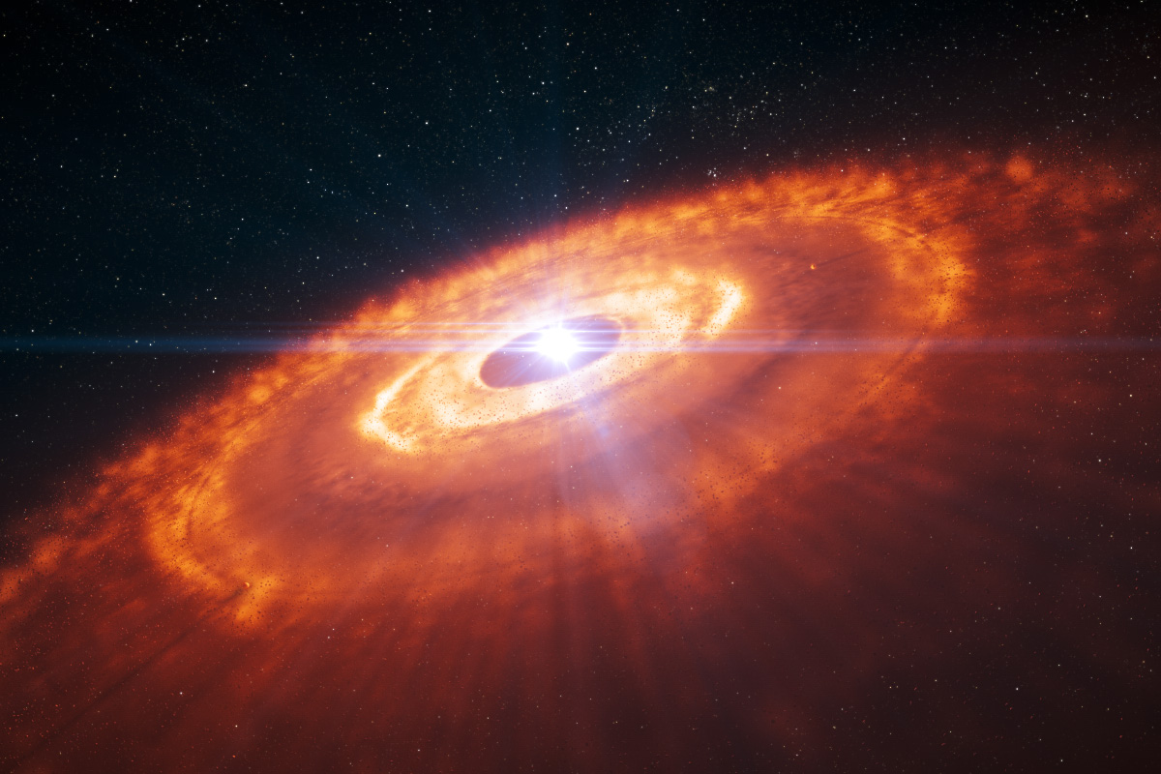
Material in this disk will form planets that orbit in the same manner as the material from which they form
- similar orbital planes
- approximately circular orbits

Slide 21
Formation of the Solar System
Gravitational Collapse
Condensation
Accretion
Nebular Capture (giant planets)
Gas clearing by solar wind
Massive Bombardments

Slide 22
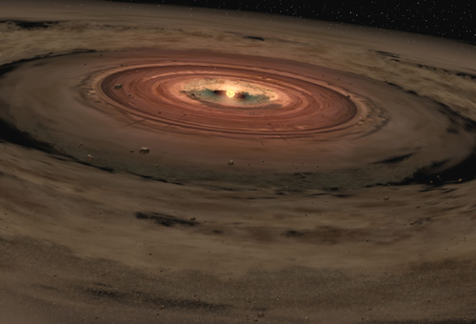
Condensation of gas into solid grains
Temperatures in proto-solar disk decreased outwards
Different materials condense at different temperatures
Highest temps: only metals (0.2%)
Somewhat cooler: metals and minerals (rocks)
Still cooler: metals, minerals and carbon grains
Coldest regions: metals, minerals, carbon grains & ices (1.4%)
H & He (98%) do not condense in grains, remain in gaseous phase
Different planets formed from different condensates
(0.4%)

Slide 23
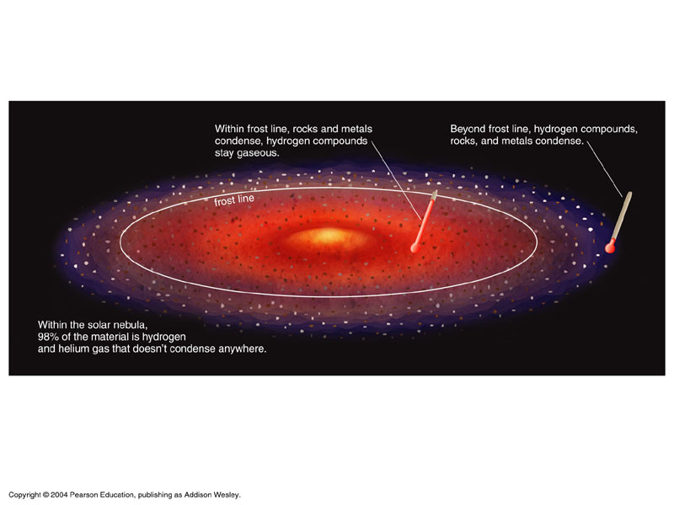
Inner Solar System: Too hot for ices & carbon grains.
Outer Solar System: Carbon grains & ices form beyond frost line
Frost line inside orbit of Jupiter

Slide 24
Formation of the Solar System
Gravitational Collapse
Condensation
Accretion
Nebular Capture (giant planets)
Gas clearing by solar wind
Massive Bombardments

Slide 25
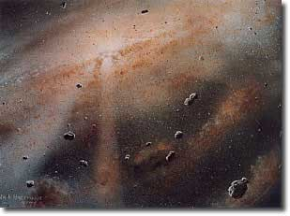
Accretion
Planetesimals: growth by accretion – colliding & sticking
Inner solar system (interior to frost line)
Planetesimals grew by accretion into the Terrestrial planets (more than exist now)
Outer solar system (exterior to frost line), Cores of giant planets formed (mostly from ice grains), accretion was not the final act for building Jovian planets

Slide 26
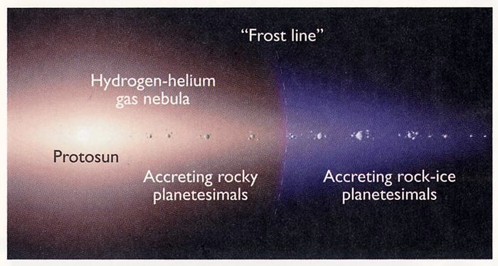
Side view of disk
Fewer planetesimals existed inside the frost frost line because only metals and minerals could condense at these higher temperatures.

Slide 27
Formation of the Solar System
Gravitational Collapse
Condensation
Accretion
Nebular Capture (giant planets)
Gas clearing by solar wind
Massive Bombardments

Slide 28
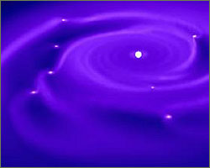
Nebular Capture & Jovian Moons
Nebular capture – outside the frost line, icy planetesimals become large enough to capture large amounts of hydrogen and helium. Led to the formation of the Giant planets
Numerous moons were formed by the same processes that formed the proto-planetary disk
Condensation and accretion created “mini-solar systems” around each Jovian planet

Slide 29
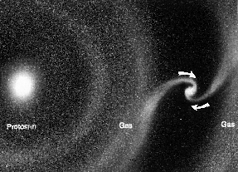
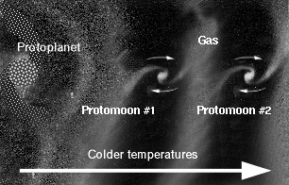
Capture of gas onto icy protoplanet lead to the growth of a gas giant planet.
Captured gas forms a disk around protoplanet. Large Jovian moons form out of this disk, creating “mini-solar systems”

Slide 30
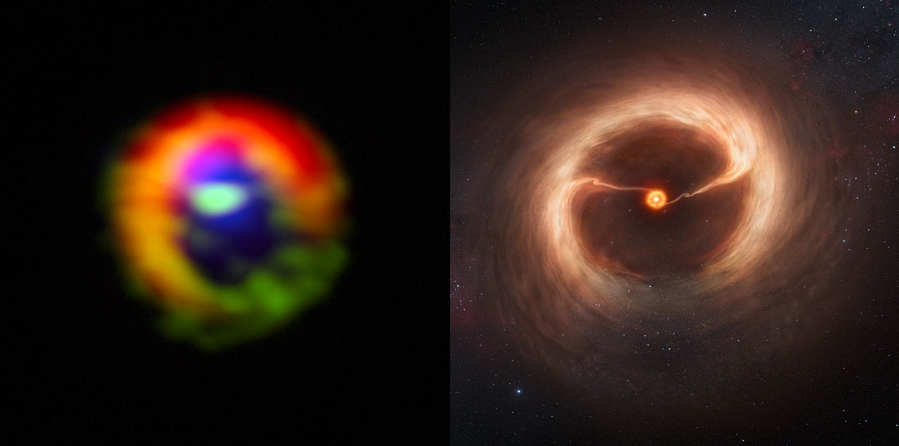
ALMA observations of nebular capture in HD 142527

Slide 31
Formation of the Solar System
Gravitational Collapse
Condensation
Accretion
Nebular Capture (giant planets)
Gas clearing by solar wind
Massive Bombardments

Slide 32
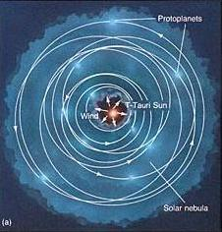
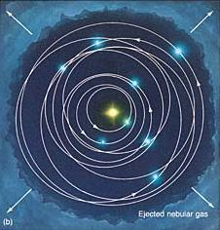
Expulsion of remaining gas
Solar wind: a flow of charged particles ejected by the Sun in all directions. It was stronger when the Sun was young.
This wind swept out most of the gas remaining in the disk

Slide 33
Formation of the Solar System
Gravitational Collapse
Condensation
Accretion
Nebular Capture (giant planets)
Gas clearing by solar wind
Massive Bombardment

Slide 34
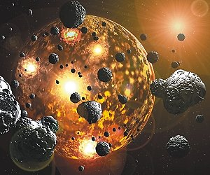
Massive Bombardment
Comets and Asteroids are the Planetesimals that remained after the clearing of the solar nebula
Many of these impacted on objects within the solar system during first few 100 million years (period of massive bombardment - creation of ubiquitous craters).

Slide 35
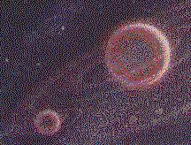
The Earth-Moon “double planet” does not fit well into the nebular theory
Planetesimal accretion predicts
both should have the same
chemical composition.
They do not; there are subtle
but significant differences
Moon is composed of less dense material than Earth

Slide 36
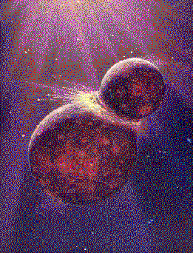
The general view is that the Earth’s moon was created as a result of the impact of a large object, perhaps as large as Mars, with the Earth very early in its existence.
The moon was formed from the debris of this collision, which included lower density “mantle” material from the Earth.

Slide 37
Problems?
Rocks returned by astronauts from the heavily cratered lunar highlands are ~ 3.9 billion yrs old – younger than solar system
Outer Jovian planets may not have had enough time to formed in their current locations

Slide 38
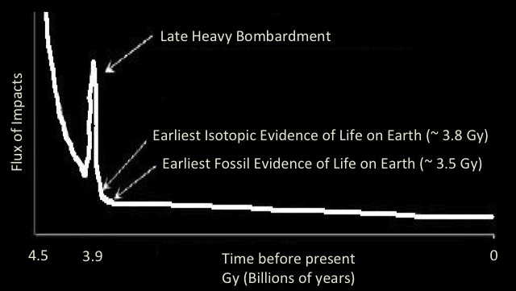
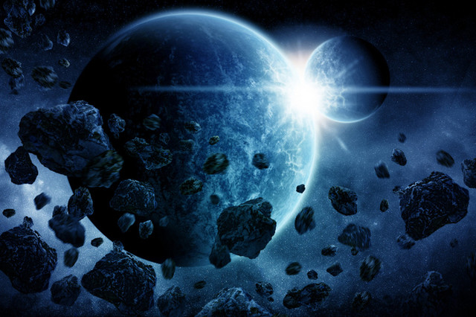
Heavy Bombardment
Late Heavy Bombardment

Slide 39
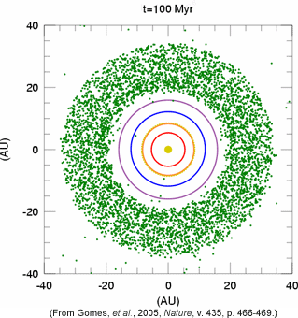
Late Heavy Bombardment (LHB)
The Nice Model
All Jovians planets formed in orbits closer to that of Jupiter
Orbital resonances between Jupiter and Saturn caused outer Jovians to move suddenly to larger orbits
Giant planets interacted with Kuiper Belt objects (green in figure), scattering them throughout the solar system
This lead to LHB, delivery of ices to Terrestrial planets, and formation of the Oort Cloud.

Slide 40
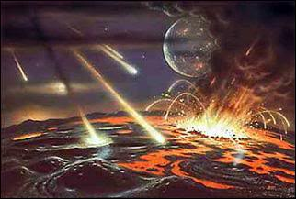
Even if life existed on Earth prior to the LHB, the LHB would have sterilized the Earth

Slide 41
now 3.8 Gy?
The oldest biological markers known to scientists date precisely to the end of the LHB, the earliest point at which life could have survived on Earth.

Slide 42
WE NOW UNDERSTAND HOW THE LOCATIONS AVAILABLE FOR LIFE (planets & Moons) WERE FORMED.
NOW, WHAT ARE THE REQUIREMENTS FOR LIFE?

